Slide 1

Team INNOVERSE

Slide 2
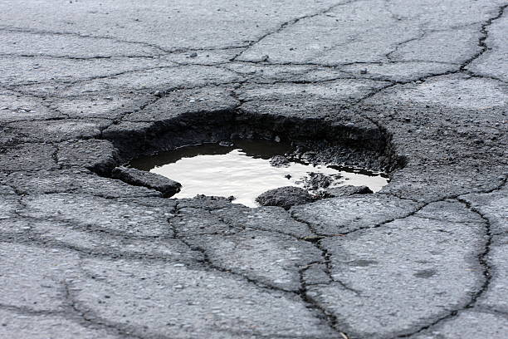
POTHOLE DETECTION SYSTEM

Slide 3
Acknowledgment
The main objective of our project was to design a pothole detection system that would benefit the people of our country in a sustainable and a cost friendly way.
We would like to express our immense gratitude to our course instructor Professor Udit Bhatia who has been very supportive and has guided us through every step of this journey.
The course has helped us acquire extensive knowledge on various principles of physics and electrical systems and has proved that ideas when put to reality gives one immeasurable satisfaction. Engineering is indeed the poetry of reality.
As a team we would also like to thank our teaching assistant Rupantar Choudhary, who has been very approachable and a pillar of support.
We finally thank our institute for introducing this very exciting and wonderful course. We are now eagerly awaiting the adventurous 4 year journey ahead of us.

Slide 4
Why potholes are a major problem?
Potholes can cause damages that are wide reaching
A pothole can lead to wheel and tire impairment,a loss of directional control and fatal accidents
According to the Ministry of Transport and highways there has been a staggering number 4775 and 3564 deaths in the years 2019 and 2020 respectively because of potholes

Slide 5

OUR IDEA
It is based on the concept of Hooke's Law.
{F=Kx}
The suspensions will experience a change
in force while going through a pothole.
This change in force will verify the
presence of a pothole.
The location will be detected and
stored for future reference.

Slide 6
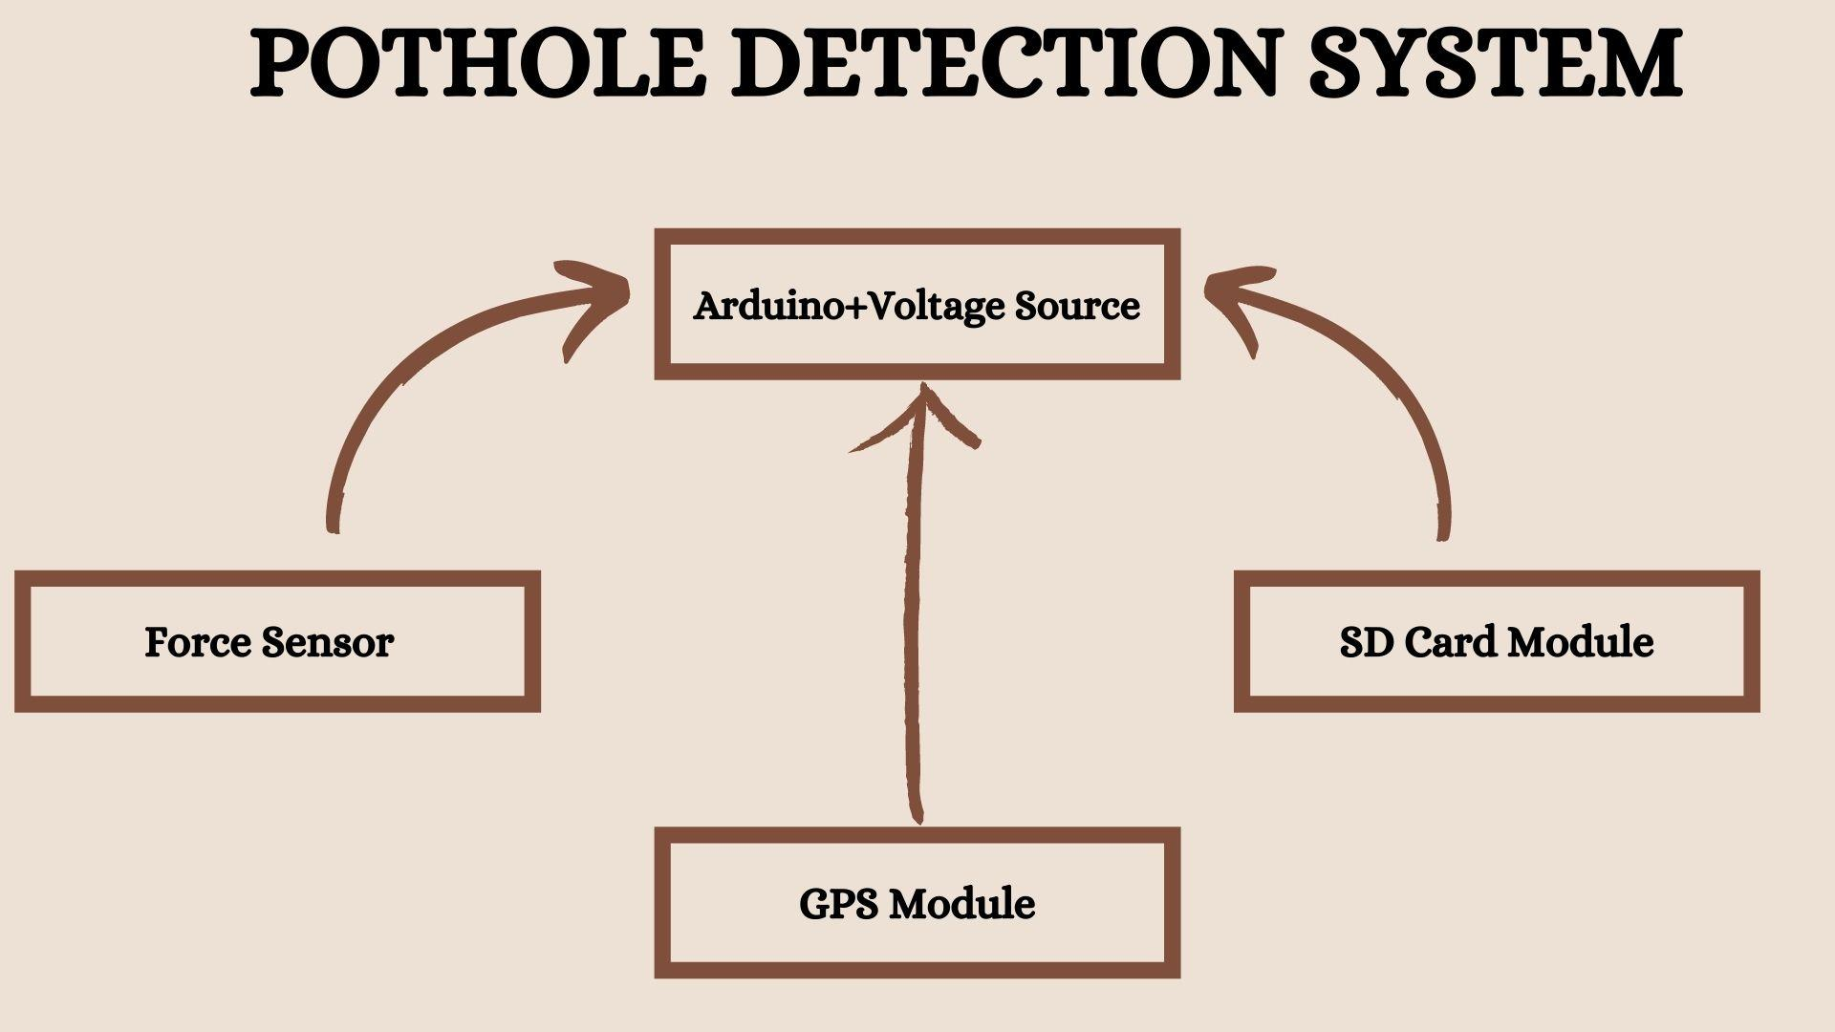
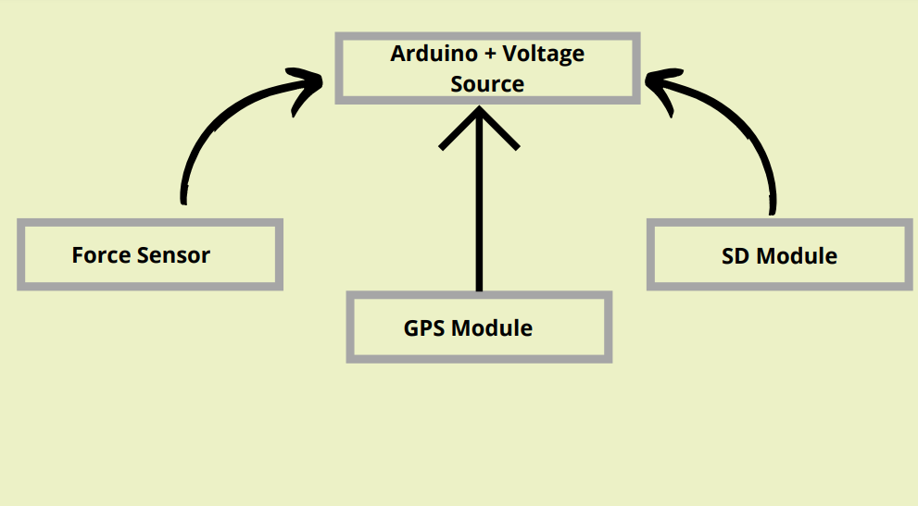

Slide 7
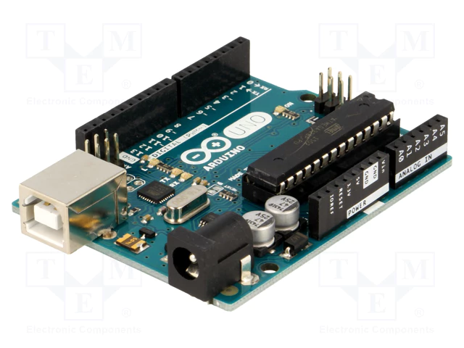
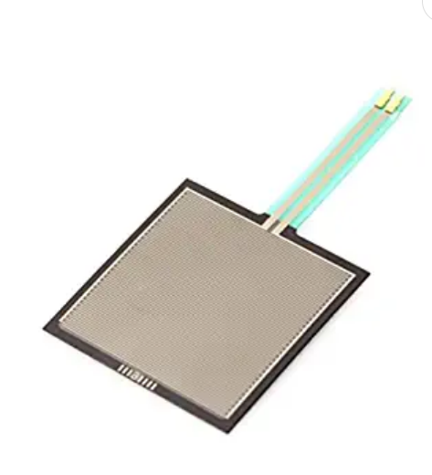
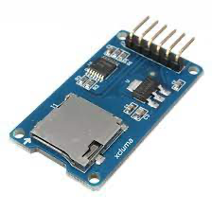
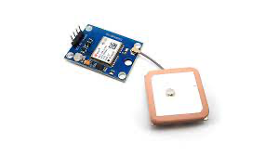
Introducing the Components
FORCE SENSING RESISTORS ARDUINO UNO
FSRs are low cost sensors used to detect
physical pressure or weight
A low cost, easy to use programmable microcontroller board
GPS MODULE
A satellite based navigation system that provides
location and time information
Used to communicate with memory card and
write or read information on them
SD CARD MODULE

Slide 9
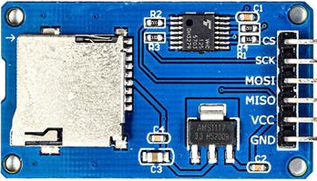
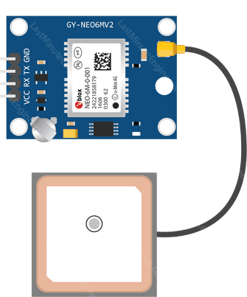
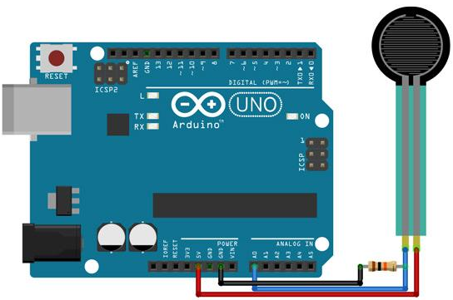
CIRCUIT DIAGRAM

Slide 10
Locating the pothole

Slide 11
Our Business Model
WHAT DO WE OFFER TO CUSTOMER?
Geospatial data (comprising the location of potholes on the regular roads)
Survey data about the terrain of roads
Accident-prone areas database
WHO IS OUR TARGET CUSTOMER?
The common people and we will use google maps to get to them
Ministry of Road Transport and Highways, Government of India
Local Municipal Authorities
HOW IS THE VALUE PROPOSITION CREATED?
Our data would be sold to the mapping firms who would make updations on the regional maps about the same
Municipal authorities would use our data to find locations to fill the potholes
WHY IS IT PROFITABLE?
We will provide our data to mapping companies and ,take some royalty from them.
Our product is cost effective

Slide 12


